Slide 1
LR(0) Parser
Given That, E → E*B
E → E+B
E → B
B → 0
B → 1
We will denote an expression as S’→ .E
E → .E*B
E → .E+B
E → .B
B → .0
B → .1

Slide 2
We will denote an expression as S’ → .E
E → .E*B
E → .E+B
E → .B
B → .0
B → .1
S’→E.
E →E.*B
E →E.+B
So, the canonical view:
E
S’ → .E
E → .E*B
E → .E+B
E → .B
B → .0
B → .1
B
0
1

Slide 3
We will denote an expression as S’ → .E
E → .E*B
E → .E+B
E → .B
B → .0
B → .1
S’→E.
E →E.*B
E →E.+B
So, the canonical view:
E
S’ → .E
E → .E*B
E → .E+B
E → .B
B → .0
B → .1
E →B.
B
0
1

Slide 4
We will denote an expression as S’ → .E
E → .E*B
E → .E+B
E → .B
B → .0
B → .1
S’→E.
E →E.*B
E →E.+B
So, the canonical view:
E
S’ → .E
E → .E*B
E → .E+B
E → .B
B → .0
B → .1
E →B.
B
0
B →0.
1

Slide 5
We will denote an expression as S’ → .E
E → .E*B
E → .E+B
E → .B
B → .0
B → .1
S’→E.
E →E.*B
E →E.+B
So, the canonical view:
E
S’ → .E
E → .E*B
E → .E+B
E → .B
B → .0
B → .1
E →B.
B
0
B →0.
1
B →.1

Slide 6
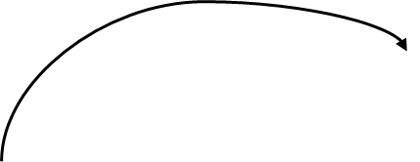
We will denote an expression as S’ → .E
E → .E*B
E → .E+B
E → .B
B → .0
B → .1
*
E →E*.B
B →.0
B →.1
S’→E.
E →E.*B
E →E.+B
So, the canonical view:
E
S’ → .E
E → .E*B
E → .E+B
E → .B
B → .0
B → .1
E →B.
B
0
B →0.
1
B →.1

Slide 7
We will denote an expression as S’ → .E
E → .E*B
E → .E+B
E → .B
B → .0
B → .1
*
E →E*.B
B →.0
B →.1
S’→E.
E →E.*B
E →E.+B
So, the canonical view:
E
+
E →E+.B
B →.0
B →.1
S’ → .E
E → .E*B
E → .E+B
E → .B
B → .0
B → .1
E →B.
B
0
B →0.
1
B →.1

Slide 8


We will denote an expression as S’ → .E
E → .E*B
E → .E+B
E → .B
B → .0
B → .1
*
E →E*.B
B →.0
B →.1
S’→E.
E →E.*B
E →E.+B
So, the canonical view:
B
E
+
E →E+.B
B →.0
B →.1
E →E*B.
S’ → .E
E → .E*B
E → .E+B
E → .B
B → .0
B → .1
E →B.
B
0
B →0.
1
B →.1

Slide 9
We will denote an expression as S’ → .E
E → .E*B
E → .E+B
E → .B
B → .0
B → .1
*
E →E*.B
B →.0
B →.1
S’→E.
E →E.*B
E →E.+B
So, the canonical view:
B
E →E+B.
E
+
E →E+.B
B →.0
B →.1
B
E →E*B.
S’ → .E
E → .E*B
E → .E+B
E → .B
B → .0
B → .1
E →B.
B
0
B →0.
1
B →.1

Slide 10
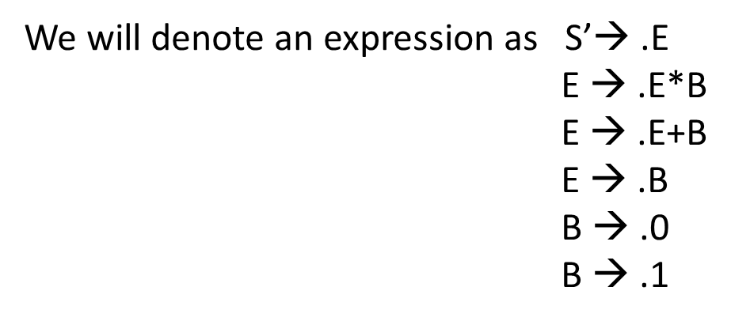
Canonical Table

Slide 11
We will denote an expression as S’ → .E
E → .E*B
E → .E+B
E → .B
B → .0
B → .1
I₅
I₁
*
E →E*.B
B →.0
B →.1
S’→E.
E →E.*B
E →E.+B
So, the canonical view:
I₈
B
E →E+B.
I₆
E
+
I₇
I₀
E →E+.B
B →.0
B →.1
B
E →E*B.
I₂
S’ → .E
E → .E*B
E → .E+B
E → .B
B → .0
B → .1
E →B.
B
0
I₃
B →0.
1
I₄
B →.1

Slide 12
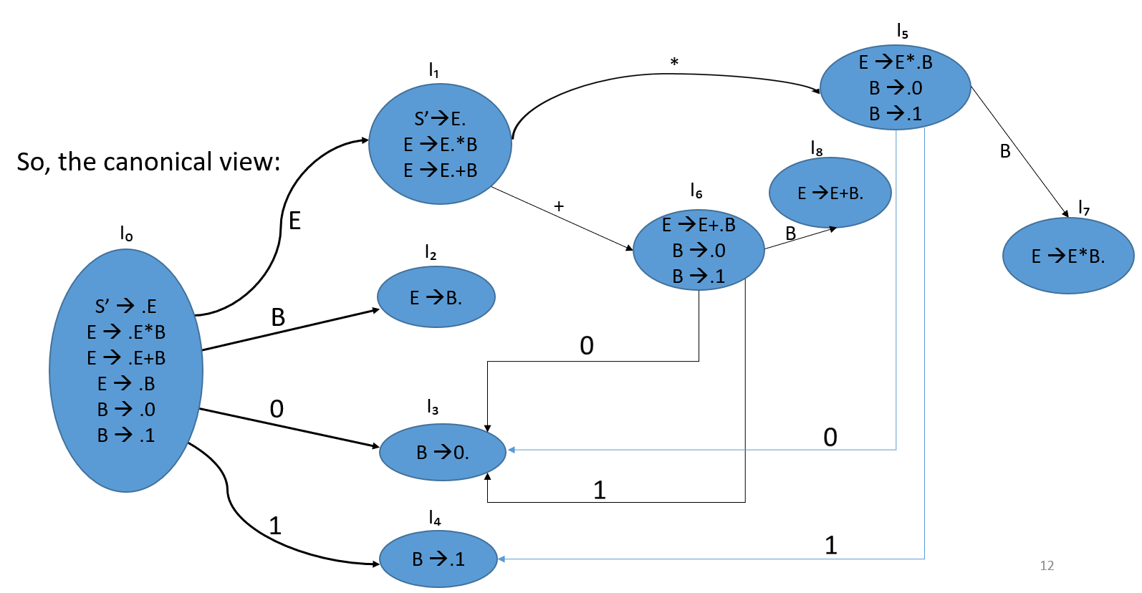
Here we can say, E → .E*B ---------1
E → .E+B ---------2
E → .B ------------3
B → .0 ------------4
B → .1 ------------5
Canonical Table
States | Action |  |  |  |  | GoTo
 | 0 | 1 | * | + | $ | E | B
I0
II
I2
I3
I4
I5
I6
I7
I8
Shift (S) = Si (1,2,3,4,5)
Reduce (r) = ri (1,2,3,4,5)

Slide 13
Here we can say, E → .E*B ---------1
E → .E+B ---------2
E → .B ------------3
B → .0 ------------4
B → .1 ------------5
Canonical Table
States | Action |  |  |  |  | GoTo
 | 0 | 1 | * | + | $ | E | B
I0 | S3 | S4 |  |  |  | 1 | 2
II
I2
I3
I4
I5
I6
I7
I8
Shift (S) = Si (1,2,3,4,5)
Reduce (r) = ri (1,2,3,4,5)

Slide 14
Here we can say, E → .E*B ---------1
E → .E+B ---------2
E → .B ------------3
B → .0 ------------4
B → .1 ------------5
Canonical Table
States | Action |  |  |  |  | GoTo
 | 0 | 1 | * | + | $ | E | B
I0 | S3 | S4 |  |  |  | 1 | 2
II |  |  | S5 | S6 | Accepted
I2
I3
I4
I5
I6
I7
I8
Shift (S) = Si (1,2,3,4,5)
Reduce (r) = ri (1,2,3,4,5)

Slide 15
Here we can say, E → .E*B ---------1
E → .E+B ---------2
E → .B ------------3
B → .0 ------------4
B → .1 ------------5
Canonical Table
States | Action |  |  |  |  | GoTo
 | 0 | 1 | * | + | $ | E | B
I0 | S3 | S4 |  |  |  | 1 | 2
II |  |  | S5 | S6 | Accepted
I2 | r3 | r3 | r3 | r3 | r3
I3
I4
I5
I6
I7
I8
Shift (S) = Si (1,2,3,4,5)
Reduce (r) = ri (1,2,3,4,5)

Slide 16
Here we can say, E → .E*B ---------1
E → .E+B ---------2
E → .B ------------3
B → .0 ------------4
B → .1 ------------5
Canonical Table
States | Action |  |  |  |  | GoTo
 | 0 | 1 | * | + | $ | E | B
I0 | S3 | S4 |  |  |  | 1 | 2
II |  |  | S5 | S6 | Accepted
I2 | r3 | r3 | r3 | r3 | r3
I3 | r4 | r4 | r3 | r4 | r4
I4
I5
I6
I7
I8
Shift (S) = Si (1,2,3,4,5)
Reduce (r) = ri (1,2,3,4,5)

Slide 17
Here we can say, E → .E*B ---------1
E → .E+B ---------2
E → .B ------------3
B → .0 ------------4
B → .1 ------------5
Canonical Table
States | Action |  |  |  |  | GoTo
 | 0 | 1 | * | + | $ | E | B
I0 | S3 | S4 |  |  |  | 1 | 2
II |  |  | S5 | S6 | Accepted
I2 | r3 | r3 | r3 | r3 | r3
I3 | r4 | r4 | r3 | r4 | r4
I4 | r5 | r5 | r5 | r5 | r5
I5
I6
I7
I8
Shift (S) = Si (1,2,3,4,5)
Reduce (r) = ri (1,2,3,4,5)

Slide 18
Here we can say, E → .E*B ---------1
E → .E+B ---------2
E → .B ------------3
B → .0 ------------4
B → .1 ------------5
Canonical Table
States | Action |  |  |  |  | GoTo
 | 0 | 1 | * | + | $ | E | B
I0 | S3 | S4 |  |  |  | 1 | 2
II |  |  | S5 | S6 | Accepted
I2 | r3 | r3 | r3 | r3 | r3
I3 | r4 | r4 | r3 | r4 | r4
I4 | r5 | r5 | r5 | r5 | r5
I5 | S3 | S4 |  |  |  |  | 7
I6
I7
I8
Shift (S) = Si (1,2,3,4,5)
Reduce (r) = ri (1,2,3,4,5)

Slide 19
Here we can say, E → .E*B ---------1
E → .E+B ---------2
E → .B ------------3
B → .0 ------------4
B → .1 ------------5
Canonical Table
States | Action |  |  |  |  | GoTo
 | 0 | 1 | * | + | $ | E | B
I0 | S3 | S4 |  |  |  | 1 | 2
II |  |  | S5 | S6 | Accepted
I2 | r3 | r3 | r3 | r3 | r3
I3 | r4 | r4 | r3 | r4 | r4
I4 | r5 | r5 | r5 | r5 | r5
I5 | S3 | S4 |  |  |  |  | 7
I6 | S3 | S4 |  |  |  |  | 8
I7
I8
Shift (S) = Si (1,2,3,4,5)
Reduce (r) = ri (1,2,3,4,5)

Slide 20
Here we can say, E → .E*B ---------1
E → .E+B ---------2
E → .B ------------3
B → .0 ------------4
B → .1 ------------5
Canonical Table
States | Action |  |  |  |  | GoTo
 | 0 | 1 | * | + | $ | E | B
I0 | S3 | S4 |  |  |  | 1 | 2
II |  |  | S5 | S6 | Accepted
I2 | r3 | r3 | r3 | r3 | r3
I3 | r4 | r4 | r3 | r4 | r4
I4 | r5 | r5 | r5 | r5 | r5
I5 | S3 | S4 |  |  |  |  | 7
I6 | S3 | S4 |  |  |  |  | 8
I7 | r1 | r1 | r1 | r1 | r1
I8
Shift (S) = Si (1,2,3,4,5)
Reduce (r) = ri (1,2,3,4,5)

Slide 21
Here we can say, E → .E*B ---------1
E → .E+B ---------2
E → .B ------------3
B → .0 ------------4
B → .1 ------------5
Canonical Table
States | Action |  |  |  |  | GoTo
 | 0 | 1 | * | + | $ | E | B
I0 | S3 | S4 |  |  |  | 1 | 2
II |  |  | S5 | S6 | Accepted
I2 | r3 | r3 | r3 | r3 | r3
I3 | r4 | r4 | r3 | r4 | r4
I4 | r5 | r5 | r5 | r5 | r5
I5 | S3 | S4 |  |  |  |  | 7
I6 | S3 | S4 |  |  |  |  | 8
I7 | r1 | r1 | r1 | r1 | r1
I8 | r2 | r2 | r2 | r2 | r2
Shift (S) = Si (1,2,3,4,5)
Reduce (r) = ri (1,2,3,4,5)

Slide 22


